Slide 1
The Market Forces
of Supply and Demand
CHAPTER
4
Notes:
This is perhaps the most important chapter in the textbook. It’s worth mentioning to your students that investing extra time to master this chapter will make it easier for them to learn much of the subsequent material in the book.
This is also one of the longest chapters in the textbook, and this PowerPoint file is one of the most graph-intensive. Many students taking economics for the first time have difficulty grasping the graphs, which are critically important in this and all subsequent chapters in the book. So an extra degree of hand-holding might be appropriate.
Accordingly, this PowerPoint has carefully detailed animations that build many of the graphs with great care. For example, we show a demand or supply schedule next to the axes, and highlight each coordinate pair in the table as the corresponding point appears on the graph.
Please be assured that the presentation of graphs is more streamlined in subsequent chapters. In this early chapter, though, we do not want to leave any students behind.
If your students are already very comfortable with scatter-type graphs, consider simplifying or turning off the animation on these slides in order to get through them faster.

Slide 2
Markets and Competition
Competitive market
Many buyers and many sellers, each has a negligible impact on market price
Perfectly competitive market
All goods are exactly the same
Buyers and sellers are so numerous that no one can affect the market price, “Price takers”
Notes:
In the real world, there are relatively few perfectly competitive markets. Most goods come in lots of different varieties—including ice cream, the example in the textbook. And there are many markets in which the number of firms is small enough that some of them have the ability to affect the market price.
For now, though, we look at supply and demand in perfectly competitive markets, for two reasons: First, it’s easier to learn. Understanding perfectly competitive markets makes it a lot easier to learn the more realistic but complicated analysis of imperfectly competitive markets. Second, despite the lack of realism, the perfectly competitive model can teach us a lot about how the world works, as we will see many times in the chapters that follow.

Slide 3
The Market Forces of Supply and Demand

Slide 4
Demand
Quantity demanded
Amount of a good that buyers are willing and able to purchase
Law of demand
Other things equal
When the price of a good rises, the quantity demanded of the good falls
When the price falls, the quantity demanded rises

Slide 5
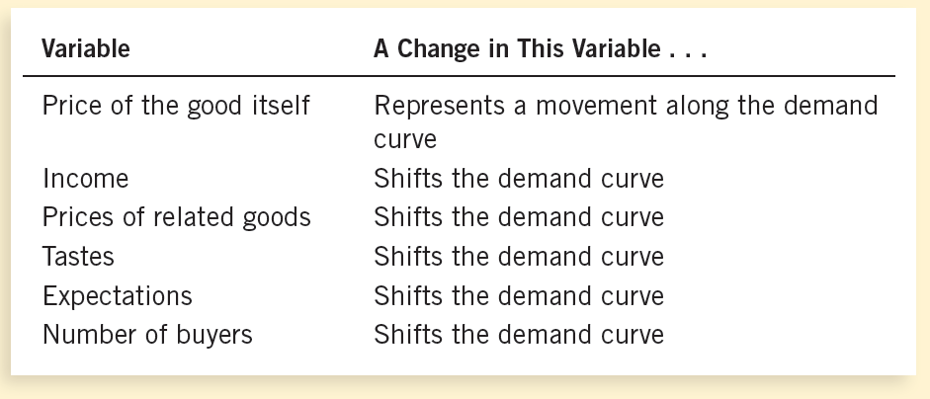
Summary: Variables That Influence Buyers
Notes:
Students should notice that the only determinant of quantity demanded that causes a movement along the curve is price. Also notice: price is one of the variables measured along the axes of the graph.
Here’s a handy rule of thumb students can use to remember whether the curve shifts: If the variable causing demand to change is measured on one of the axes, you move along the curve. If the variable that’s causing demand to change does not appear on either axis, then the curve shifts.
This rule of thumb works with all curves in economics that involve an X-Y relationship, including the supply curve, the marginal cost curve, the IS and LM curves (not covered in this book), and many others, though it does not apply to curves drawn on time series graphs.
For an interesting break, you can discuss the case study ‘Two ways to reduce the quantity of smoking demanded’ on how to reduce smoking:
1. Use public service announcements, mandatory health warnings on cigarette packages, and prohibition of cigarette advertising on television to decrease the demand for cigarettes and other tobacco products.
2. Tax the manufacturer, and decreasing the quantity demanded (movement along demand curve). Studies showed:
10% ↑ in price → 4% ↓ in smoking
Teenagers: 10% ↑ in price → 12% ↓ in smoking

Slide 6
The Market Forces of Supply and Demand

Slide 7
Supply
Quantity supplied
Amount of a good
Sellers are willing and able to sell
Law of supply
Other things equal
When the price of a good rises, the quantity supplied of the good rises
When the price falls, the quantity supplied falls
Notes:
Supply comes from the behavior of sellers.

Slide 8
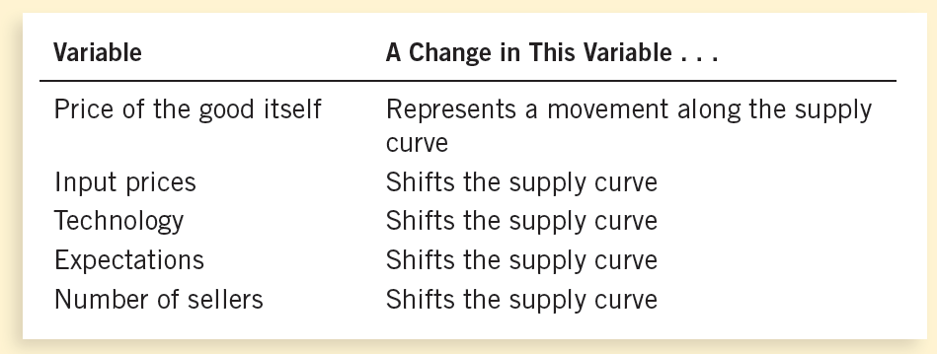
Summary: Variables That Influence Sellers

Slide 9
Supply and Demand Together
P
Equilibrium: Price has reached the level where quantity supplied equals quantity demanded
D
S
Q
Notes:
In equilibrium, various forces are in balance. A situation in which market price has reached the level where Quantity supplied = Quantity demanded; where supply and demand curves intersect

Slide 10
The Market Forces of Supply and Demand

Slide 11
EXAMPLE 3: A Shift in Both Supply and Demand
EVENTS: Price of gas rises AND new technology reduces production costs
STEP 1: Both curves shift.
STEP 2: Both shift to the right.
STEP 3: Q rises, but the effect on P is ambiguous:
If demand increases more than supply, P rises.
P
S₁
S₂
P₂
P₁
D₁
D₂
Q
Q₁
Q₂

